Slide 1

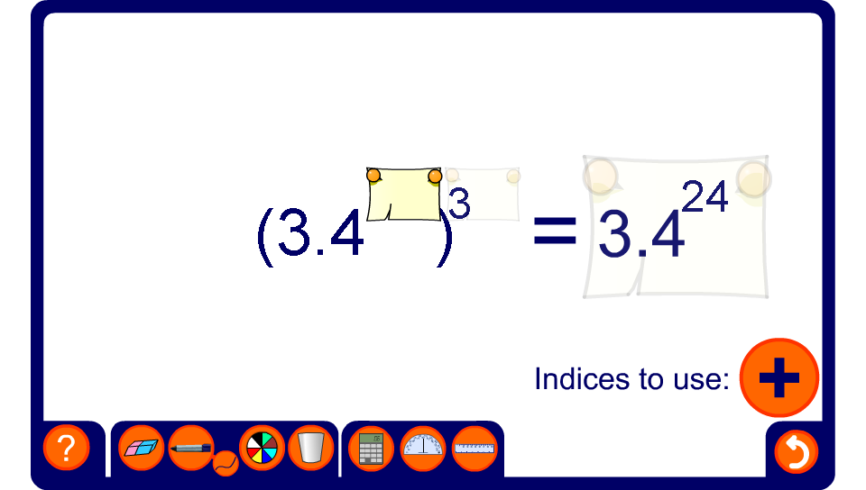


Using index laws
Notes:
Solve each problem by adding, subtracting and multiplying the indices. You may choose to include negative indices if required.

